Slide 1
Investments 3600
Adam Schor
Week 2 Lecture Slides

Slide 2
Investment Approaches:
Fundamental
    Top Down vs. Bottom Up
    Active vs. Passive
Technical
Quantitative
In these slides we will are looking at valuation as part of a fundamental investment style.
Notes:
Last week we looked at risk and return. We will talk about how to calculate risk in later weeks. This week we will talk about equity valuation using two models, the dividend discount model and the discounted cash flow model. When we think about return, you need to think about what you would pay today for your expected future cash flows to get your required level of return. Both models are standard for any fundamental analyst trying to determine fair value for a given level of risk. It is worth taking a moment, therefore, to understand what a fundamental approach is and how it differs from other investment approaches. Fundamental investing involves specific security analysis and selection. It can be top-down, where you might start with a macro or economic assumption and use that to get to the stocks you want to own. A top down approach might be to pick a country or sector that you think will do well and then move down from there to pick stocks in that sector or country. A bottom-up approach will start at the stock level and then take into account the sector, country or other factor exposures that come about.
In either case, if you are picking individual stocks, then you are an active investor. If you are just populating a portfolio to match an index, then you are a passive investor.
Fundamental investing differs from technical investing, which uses behavioral factors and past price performance to suggest. While it can be complex, the underlying assumption is that past price patterns repeat and inform about future price action. I am skeptical about this approach. We will discuss it later when we look at market efficiency.
Quantitative investing typically involves no fundamental company knowledge but picks stocks based on factors that have shown to be successful. A quant model may favor high ROE stocks or low volatility stocks and so. These strategies are typically based on computer models that scour data for historical patterns that could repeat.

Slide 3
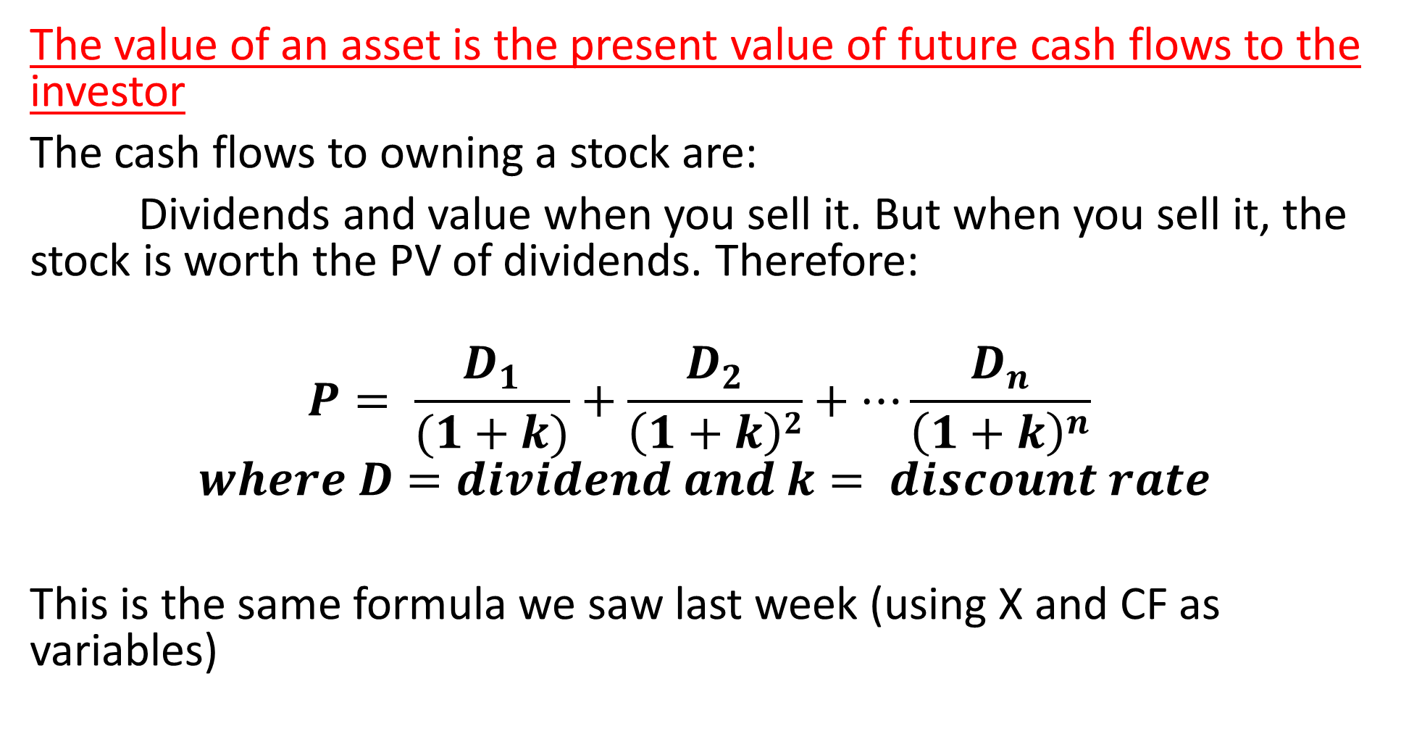
The value of an asset is the present value of future cash flows to the investor
The cash flows to owning a stock are:
Dividends and value when you sell it. But when you sell it, the stock is worth the PV of dividends. Therefore:
$$P= \frac{D_{1}}{(1+k)}+\frac{D_{2}}{\left(1+k\right)2}+…\frac{D_{n}}{{\left(1+k\right)}^{n}}$$
$$where D=dividend and k= discount rate$$
This is the same formula we saw last week (using X and CF as variables)
Notes:
Remember our key tenet: The value of an asset is the present value of future cash flows to the investor. For equites the cash flows are the dividends you receive after you own the stock and the value you expect to sell the stock for in the future. But your sell price is somebody else’s buy price and that person is buying based on future dividends. Therefore, the value of a stock is simply the present value of future dividends, discounted back for the appropriate risk level.

Slide 4
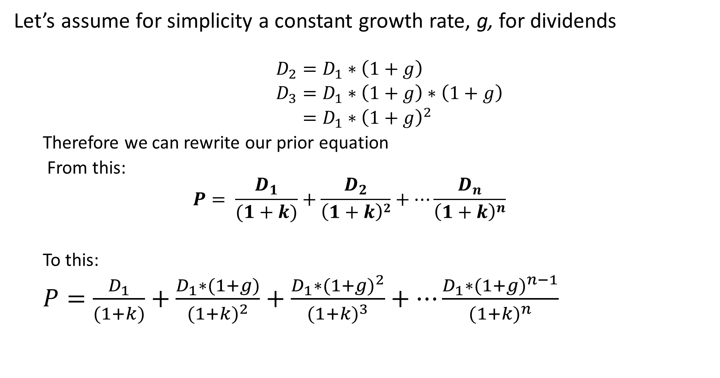
Let’s assume for simplicity a constant growth rate, g, for dividends
  $$D_{2}=D_{1}∗\left(1+g\right)$$
  $D_{3}=D_{1}∗\left(1+g\right)∗\left(1+g\right)$
  $=D_{1}∗{\left(1+g\right)}^{2}$
  Therefore we can rewrite our prior equation
  From this:
  $$P= \frac{D_{1}}{(1+k)}+\frac{D_{2}}{\left(1+k\right)2}+…\frac{D_{n}}{{\left(1+k\right)}^{n}}$$
  To this:
  $P=\frac{D_{1}}{(1+k)}+\frac{D_{1}∗(1+g)}{{(1+k)}^{2}}+\frac{D_{1}∗{(1+g)}^{2}}{{(1+k)}^{3}}+…\frac{D_{1}∗{(1+g)}^{n−1}}{{(1+k)}^{n}}$
Notes:
I think this slides is clear. It shows a mathematical formula that represents the PV of an infinite stream of dividends.

Slide 5
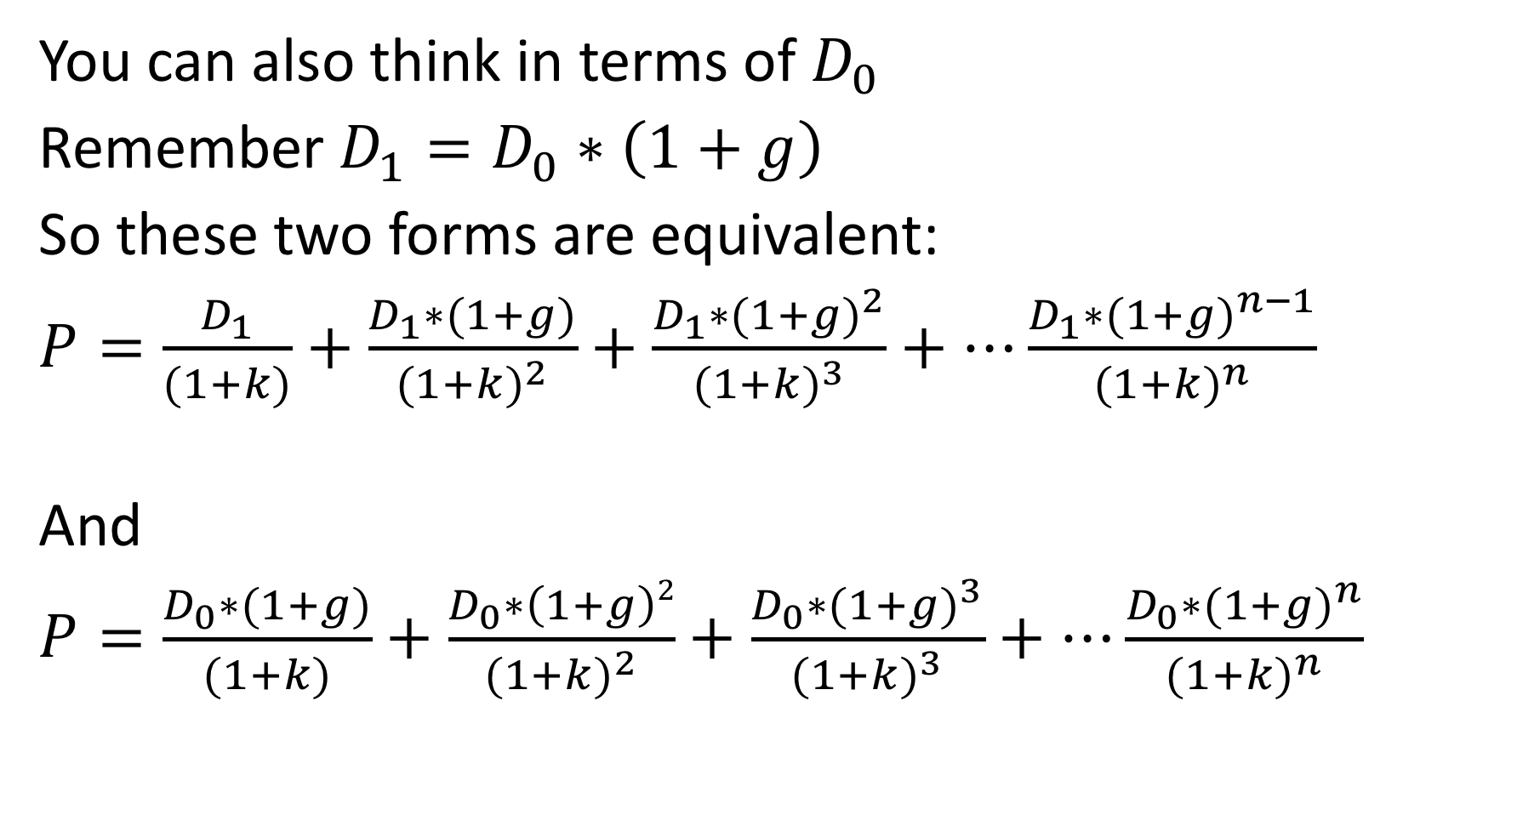
You can also think in terms of $D_{0}$
Remember $D_{1}=D_{0}∗\left(1+g\right)$
So these two forms are equivalent:
$P=\frac{D_{1}}{(1+k)}+\frac{D_{1}∗(1+g)}{{(1+k)}^{2}}+\frac{D_{1}∗{(1+g)}^{2}}{{(1+k)}^{3}}+…\frac{D_{1}∗{(1+g)}^{n−1}}{{(1+k)}^{n}}$
And
$P=\frac{D_{0}∗(1+g)}{(1+k)}+\frac{D_{0}∗\left(1+g\right)2}{{(1+k)}^{2}}+\frac{D_{0}∗{(1+g)}^{3}}{{(1+k)}^{3}}+…\frac{D_{0}∗{(1+g)}^{n}}{{(1+k)}^{n}}$

Slide 6
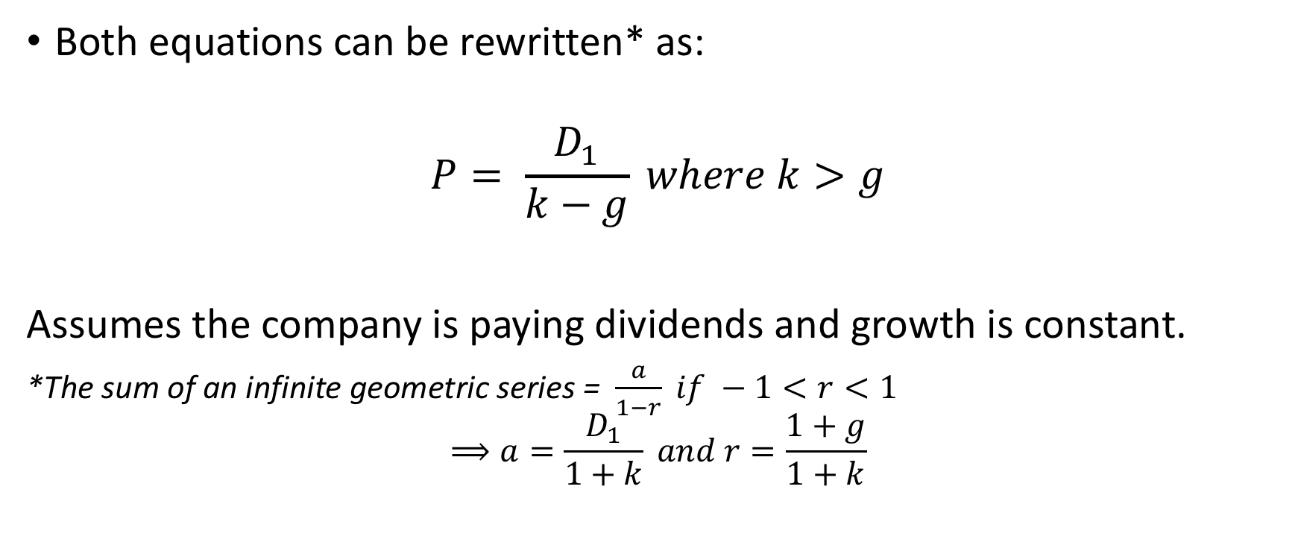
Dividend Discount Model
Both equations can be rewritten* as:
$$P= \frac{D_{1}}{k−g} where k>g$$
Assumes the company is paying dividends and growth is constant.
*The sum of an infinite geometric series = $\frac{a}{1−r} if −1<r<1$
$$⟹a=\frac{D_{1}}{1+k} and r=\frac{1+g}{1+k}$$
Notes:
That equation from the previous slides can be simplified to this equation, which is the Dividend Discount Model. There is no magic in the transformation; rather it follows the formula for finding the sum of an infinite geometrical series. You will need to know this formula but not the math behind it. However, I want you to understand that the DDM is simply another way to consider the PV of future dividends.
The DDM is commonly used by investment analysts. You should be familiar with it and its variations – for exams and if you want to be in the investment business.

Slide 7
Question 1
Assume ABC paid a $1 dividend yesterday. You predict a sustainable growth rate of 3% from this point forward. You also require a 10% discount rate.
Note: For simplicity, we use annual dividends. In practice, companies pay quarterly or (often outside the U.S) semi-annual dividends. Most users of a DDM will just use the total dividends paid over a year, without adjustments.

Slide 8
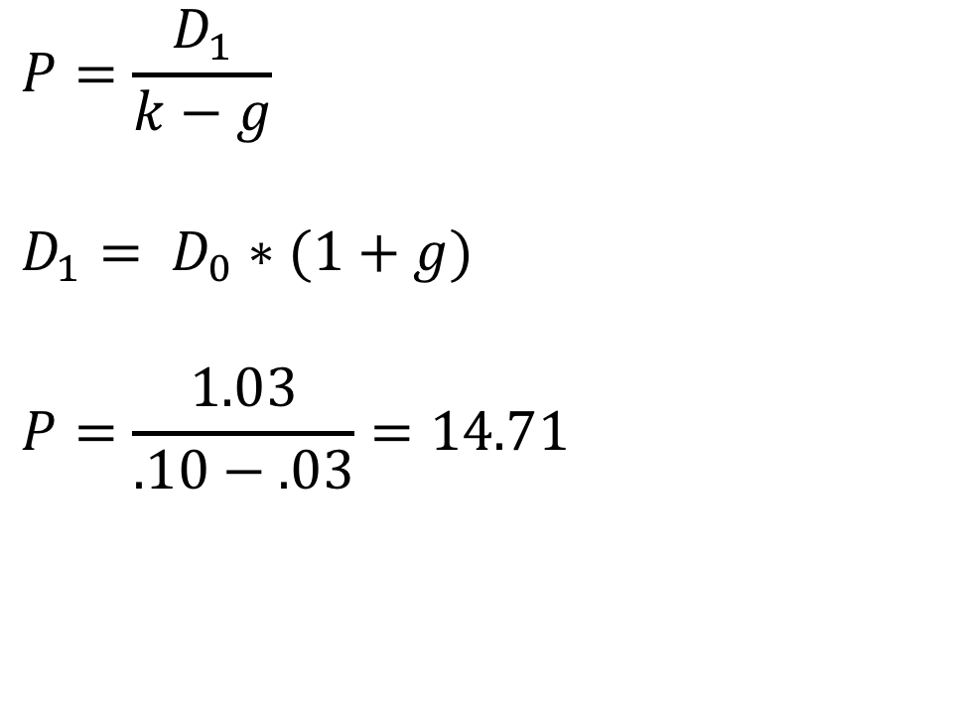
Answer 1
$$P=\frac{D_{1}}{k−g}$$
$$D_{1}= D_{0}∗(1+g)$$
$$P=\frac{1.03}{.10−.03}=14.71$$

Slide 9
Question 2
From question 1, we have: ABC paid a $1 dividend yesterday. You predict a sustainable growth rate of 3% from this point forward. You also require a 10% discount rate
If the stock trades at $11.44, what does the price imply about the market’s expected growth rate for this company. Assume the discount rate is still 10%. What would you do as an investor? Buy, Sell or Hold?
Now assume the stock is at $20.60 and the discount rate is still 10%. Find the market’s expected growth rate. What would you do as an investor? Buy, Sell or Hold?

Slide 10
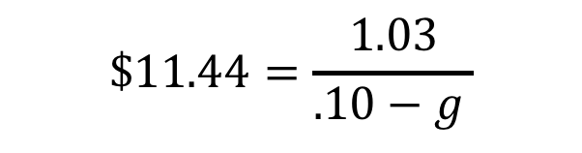
Answer 2
A. Solve for the missing variable.
Solve for g. g = 0.01 or 1%. If you think that growth is 3% and the market is pricing in 1%, then you should buy!
B. Left for the student and homework
$$\$11.44=\frac{1.03}{.10−g }$$

Slide 11
The multi-stage DDM
What if there are varying growth rates:
The DDM assumes constant growth in dividends. Value the periods prior individually. In other words, use the DDM as the terminal value.
For example: Consider a company where you project the following dividend policy. You’re required rate of return is 10%
Year | Dividend
1 | $1.00
2 | $1.10
3 | $1.20
Then terminal growth rate of 5%
Notes:
The DDM assumes a constant growth rate that is less than our discount rate. Without these assumptions, you cannot use. Therefore, you defer to a multi-stage DDM which is really just discounting each dividend back and then applying the DDM in the future, when the assumptions hold.

Slide 12
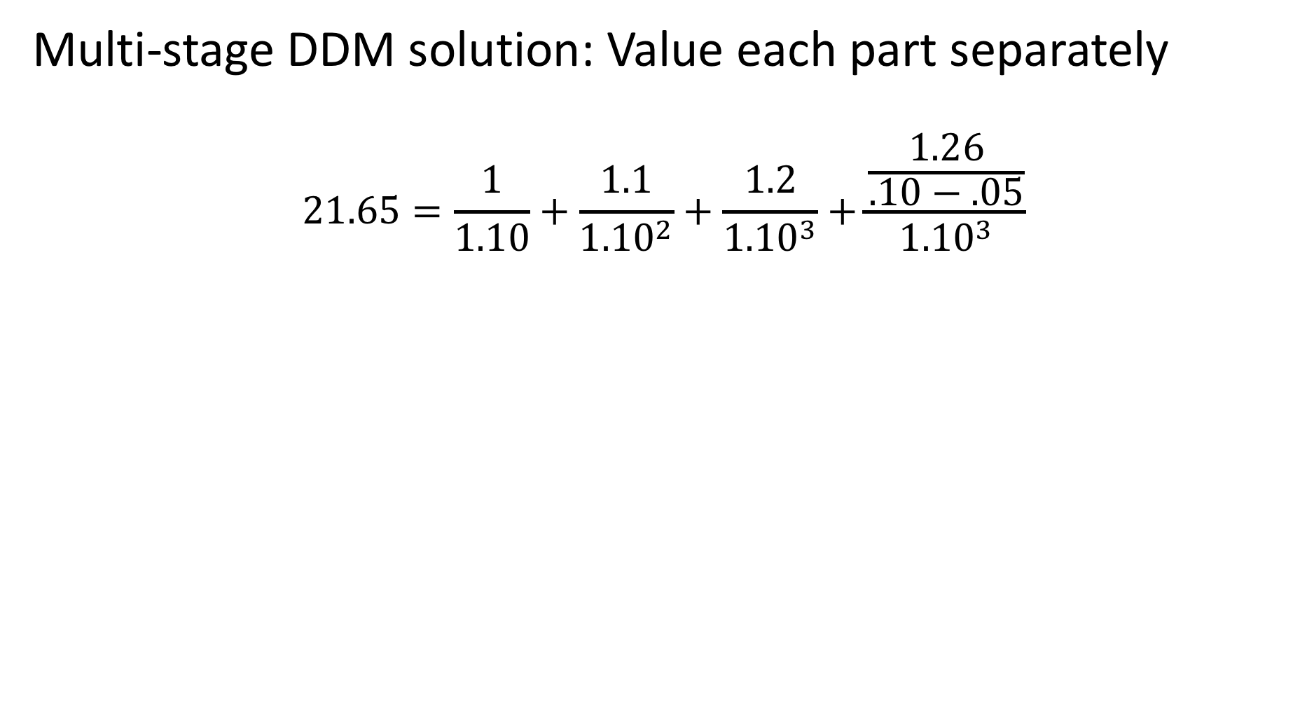
Multi-stage DDM solution: Value each part separately
$$21.65=\frac{1}{1.10}+\frac{1.1}{{1.10}^{2}}+\frac{1.2}{{1.10}^{3}}+\frac{\frac{1.26}{.10−.05}}{{1.10}^{3}}$$
This is the DDM applied once constant growth begins. But note you have to discount the value to today. Also notice how much of the value is in the terminal period.

Slide 13
Question 3
Consider this pattern based on your estimates. Value the stock using a 10% required rate of return
Year | EPS | Dividend Payout Ratio
1 |  | 25%
2 |  | 40%
3 |  | 50%
After year 3, the company has a 6% steady growth rate and a 60% payout ratio

Slide 14
Dividend Irrelevance Theory proposed by Modigliani and Miller. It states that dividend policy does not matter because an investor can replicate the cash flows through buying and selling stock and the company can allocate capital, including dividends, based on IRR profiles rather than a set dividend policy.
Assumptions:
  No taxes (or at least differences between capital gains and ordinary income)
  No transaction costs
  Company leverage does not matter (or have tax advantages)
  Companies ignore capital dividends in capital budgeting
  Leverage does not impact cost of capital
Therefore, it is more theoretical than practical but it does inform how investors and companies can think about dividends. While our formula depends on dividends, companies that don’t pay dividends can be valuable.
Notes:
This is not in the book but an important concept to consider. It helps understand how to value companies that do not pay dividends now. It also will help when we look more closely at price-to-earnings ratios. The theory basically says an investor is indifferent to dividends because she can always replicate the cash flow of dividends by selling shares, or buying them if she wants to reinvest the paid out capital. From a company, it can pay cash to shareholders or reinvest it on their behalf in projects with at least a return demanded by shareholders. The company will pass on projects below a reasonable return level and return the cash to shareholders in dividends. If it needs more cash later, it can raise money from shareholders. Therefore, in theory, the company and shareholder is indifferent to dividend policy.
There are several key and unrealistic assumptions in the theory but it has some relevance. In short, a company retaining cash to reinvest in the business is generating value for shareholders that eventually lead to earnings and when the projects are fewer lead to dividends.

Slide 15
Yes, the DDM can still apply to a company that does not pay dividends.
Why:
Assume that it will at some point pay dividends and value for that point
Using dividend irrelevance, assume dividend payouts and adjust growth if needed. (Theoretically sound but less common)
Value on P/E but remember that the DDM ties to the P/E ratio of a stock. (More on this point later)
Notes:
Therefore, the DDM can be used on a non-dividend paying company and, of course, they still have value. You can value the future point when dividends begin, replicate dividends and adjust growth, or focus on the price earnings ratio – which is tied to the DDM.

Slide 16
Cash Flow Models
The DDM is an earnings based model. Another model is a discounted cash flow model. (The book calls it a FCF model but DCF is more common).
The key difference: DDM values cash flows (dividends) to equity holders. DCF values the entire business and looks at what part of that value applies to equity holders.
Note: The book looks at EVA (what the book calls RIM or Residual Income Model). Enterprise Value Added is an important concept but rarely used for valuation. We will address it later as part of forecasting. We will also look at the components of ROE then)
Notes:
A second common model that any stock analyst should know is the discounted cash flow model. It differs from the DDM because it focuses on cash flow rather than earnings. It also values the entire business and then sees what is left to equity holders. A DDM values just the equity stake.
Remember, however, that both are using the concept of PV of future cash flows. In a perfect world, these models should get you the same result. Of course, in reality, they don’t. But if you have big discrepancies when you value a company with both models, you are probably missing something in your analysis and your reconciliation between earnings and cash flow.

Slide 17
Assets = Liabilities + Equity. So once you value a company as a whole you can separate the components to the equity holders and the liability holders.
So value the business first. The term we use for the value of the business is Enterprise Value.
Consistent with our previous comments, the EV equals the present value of future cash flow to the business.
Notes:
The simple equation of accounting is that Assets = Liabilities + Equity. While accounting values may differ from market values, the concept is the same. The business value equals the market or present value of liabilities and the market value of equity. So value the business, subtract the liabilities and you’re left with the equity value.
Again, this is a quite common way to value businesses or to value stocks. It is especially used for absolute valuation approaches, where you are thinking about buying a business rather than a relative approach, where you may decide that one stock is cheaper than another but don’t judge if both might be over-valued. It is how private equity thinks about business because when you buy a company, you pay for both the equity and the liabilities and then you own the business. In fact, I first learned this method not in business school but early in my career from another analyst who used to work in valuation department of a major accounting firm.

Slide 18
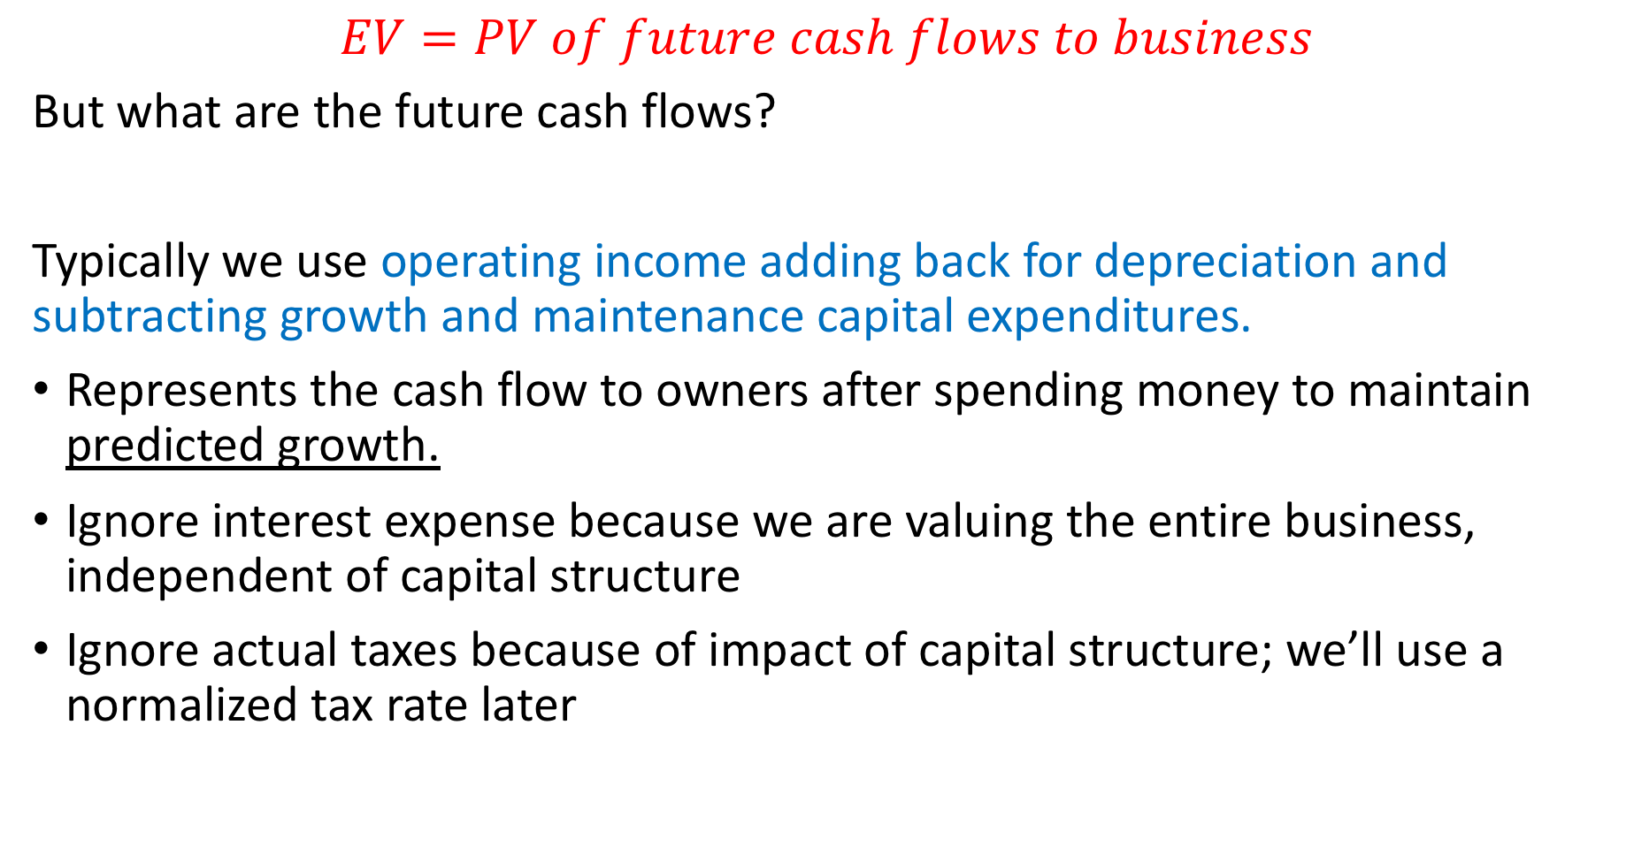
$$EV=PV of future cash flows to business$$
But what are the future cash flows?
Typically we use operating income adding back for depreciation and subtracting growth and maintenance capital expenditures.
Represents the cash flow to owners after spending money to maintain predicted growth.
Ignore interest expense because we are valuing the entire business, independent of capital structure
Ignore actual taxes because of impact of capital structure; we’ll use a normalized tax rate later
Notes:
Take the PV of future cash flows to the business. For cash flow, we typically start with operating income or earnings before interest and taxes (EBIT). We ignore interest expense because we don’t care about the capital structure because we are valuing the equity and the liability. So a company with 100% debt/equity has the same enterprise value as a company with no debt, if the cash flows are the same. We need to adjust EBIT for non-cash items, such as depreciation and amortization, getting us EBITDA. A lot of people stop here. But companies need to invest to keep their businesses going. So we add back maintenance cap ex. (In theory, depreciation = maintenance cap ex). You also may assume the business needs to use cash for the growth you anticipate, either in working capital and additional cap ex. Therefore, we take those numbers out of the FCF figure. Some refer to this final figure as EBITDAX to account for cap ex.
The key is that you are thinking: If this company were private and I owned 100%, what FCF would I get after I spent what I need to spend to keep it going.
We ignore taxes here because tax rates are impacted by capital structure. Remember, interest expense is tax deductible. We will apply a normalized tax rate later.
Once you have the FCF, it is a simple matter of discounting it back. You must also account for a terminal value. You can use our DDM approach of (k-g) as a way to value the future value after the company goes into normal growth.

Slide 19
DCF Continued
Once you have the value, you need to make adjustments for parts of enterprise value that the equity holders don’t own.
Enterprise value
- Long-term debt, pensions, contingent liabilities, minority interests
- Working capital needed for growth
+ Excess cash on hand
+ Other assets, including non-monetized assets
= Equity Value
Equity Value/# of shares = per share value
Notes:
The PV of free cash flow is the business value or enterprise value. Next you need to see what is left over for equity holders.
You subtract liabilities, minority interest and working capital needed for growth. Note, you can take working capital out of cash flows or just allocate a lump sum here. It is the same.
Add back excess cash and add in assets that have value but are not generating income. This could be excess land, shares in another company that are not consolidated. It could also be assets that may generate cash in the future. Facebook’s Messenger App could be an example, as the company has not really harvested profits from its massive user base.
After you add and subtract these items, what is left is the equity value. Divide by shares outstanding and you have a target share price. This represents the value you would be left with if you bought all the company and then satisfied the claim of liability holders and other claims on the business.

Slide 20
DCF Example: Step 1
Assume Company A has the following projections. After year 5, the company will have a constant growth of 3% and cap ex will equal depreciation. Growth does not require additional working capital.
Year | 1 | 2 | 3 | 4 | 5
Oper Income | 125,000 | 135,000 | 145,000 | 170,000 | 190,000
+ Depreciation | 20,000 | 21,000 | 22,000 | 23,000 | 24,000
- Maint. Cap Ex | (15,000) | (15,000) | (15,000) | (15,000) | (15,000)
 | 130,000 | 141,000 | 152,000 | 178,000 | 199,000
- Taxes at 21% | (27,300) | (29,610) | (31,920) | (37,380) | (41,790)
Free Cash Flow | 102,700 | 111,390 | 120,080 | 140,620 | 157,210
10% discount rate | 1.10 | 1.21 | 1.33 | 1.46 | 1.61
FCF Discount to Today | 93,364 | 92,058 | 90,218 | 96,045 | 97,615
Sum of Discounted CF | 469,300 |  | 195,700 | Year 6 FCF
Terminal Value | 2,208,614 |  | 154,603 | After 21% Tax
EV | 2,677,914 |  | 7% | Capitalized at k-g
 |  |  | 2,208,614

Slide 21
DCF Example: Step 2
Assume the company has long term debt of $500,000, cash of $50,000, minority interest of $100,000. It also has a lawsuit that the company thinks it will win but you are 80% certain it will lose and have to pay $500,000. Finally, there are 1 million shares outstanding.
Enterprise Value | 2,677,914
Long Term Debt (Market) | (500,000)
Cash | 50,000
Minority Interest | (100,000)
Contingent Liability | (400,000) | 80% of 500,000 settlement
Value to Equity Holders | 1,727,914
Per Share | $ 1.73 | 1 million shares

Slide 22
DCF Conclusion
As company pays down debt, equity value increases as more EV goes to equity holders
Works well with companies with large cash balances
Adjusts for assets that have value but are not yet generating income or cash flow
Provides a check on earnings based models by reconciling cash flow with earnings
Notes:
The DCF approach is quite common and works often for companies generating cash but not as much earnings. It also shows how a company that pays down debt transfers value to shareholders. EV/EBITDA and EV/EBIT are common valuation metrics. EV/Sales is another. If you assume a normal margin, you can use it to value a company in a start up phase where profitability lags revenue acquisition. Consider a software company with high upfront selling costs but then a long-term, profitable customer relationship. By the way, P/Sales is mentioned in the book but is meaningless because it does not account for the capital structure.

Slide 23
Question 4
Use a DCF model and the following data to estimate the per share value
(in millions, except shares out) | Year 1 | Year 2 | Year 3 | Year 4 | Year 5
Operating Income | 127.2 | 136.4 | 142.4 | 150.5 | 128.8
Depreciation | 12 | 12 | 12 | 12 | 12
Cap Ex | 10 | 11 | 12 | 12 | 12
Other Info
Tax Rate | 21% | Discount Rate | 10%
Long Debt | 400 | Terminal Growth | 4%
Pension Liability | 200
Shares Out | 50 million

Slide 24
Using Valuation Ratios
Often stocks trade in terms of the ratio of price/earnings, price/book, EV/FCF, EV/Sales, among others*
These do not replace our valuation models. They are short-hand approximations
We can use our valuation models and compare the outcome to similar companies, to the market or to history to test it
*The book mentions Price/Sales. That is wrong and not a useful valuation ratio.
Notes:
Once you have a target price, you can compare it to earnings and cash flow and get the P/E ratio or EV/EBITDA ratio, for example. But the common question is: What is the right number? The right number of course is what your valuation models tell you, assuming you have perfect foresight. In reality, it is nice to compare your ratios to historical levels of the company, to similar companies and to the market. If your company trades as ratios (the common term is “mulitples”) that are higher than history, ask why the company is better now. If the multiples are higher than competitors, ask if your company is going to grow more. And so on. Use multiple analysis as a reality check on the outcomes of your valuation models.

Slide 25
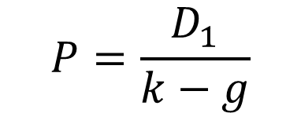
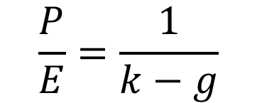
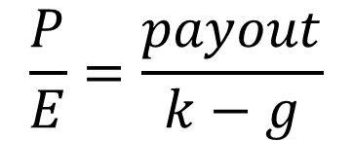
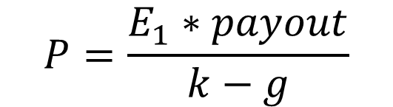
P/E and the DDM
$$P=\frac{D_{1}}{k−g}$$
Assume k = 10%
g | P/E
9% | 100.00
8% | 50.00
7% | 33.33
6% | 25.00
5% | 20.00
4% | 16.67
3% | 14.29
2% | 12.50
1% | 11.11
$$P=\frac{E_{1}∗payout}{k−g}$$
$$\frac{P}{E}=\frac{payout}{k−g}$$
$$\frac{P}{E}=\frac{1}{k−g}$$
Notes:
Note that the P/E ratio comes out of the DDM. Using dividend irrelevance, you can see that the P/E should equal 1/(k-g). Of course, it is simplified model but the relationship is important. Also, look at the graph. Notice that a 1% change in expected growth rate, g, in a high P/E stock changes the P/E ratio and therefore the price must more dramatically than when the P/E is lower. This is another reason why high P/E stocks are more vulnerable to growth scares. It should help you understand why Netflix fell sharply early in the summer after subscriber growth disappointed the market, for example.

Slide 26
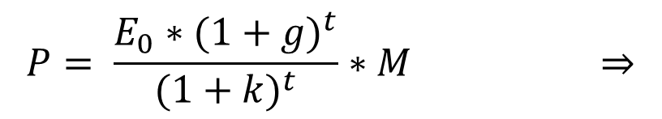

How to tie growth, risk and time
Assume:
A company grows faster than the market for time T. Then it returns to an average market level of growth. All companies must do this
At time T, when the company is normal, the stock will have a market multiple of M
Assume no dividends until Time T and then 100% payout. (Simplifying, not crucial assumption. Remember dividend irrelevance.)
$$\frac{P/{E_{0}}}{M}= \frac{{(1+g)}^{t}}{{(1+k)}^{t}}$$
$$P= \frac{E_{0}∗{(1+g)}^{t}}{{(1+k)}^{t}}∗M ⇒$$
When comparing a multiple to another company or to the market, you must consider the relative rates and the relative durations of above market growth.
Notes:
The P/E ratio is a function of growth but it is also a function of the duration of this growth. Every company as some point must revert to a market or economy rate of growth. They get impossibly big or small otherwise. At this point, we can assume they will have a P/E equal to the market. Let’s use M for that market multiple. The question is if the company grows faster than the market, how much bigger should the P/E be relative to M. This formula, based on what we’ve discussed so far, shows you that it is a function of the rate and the duration of the super normal growth. Remember to use E(0) rather that E(1) to avoild double counting growth.

Slide 27
Question 5
What stock deserves a higher P/E multiple to trailing earnings given the data in this chart, which shows the rate and duration of super normal growth, before fading to a normal market rate of growth of 5%. Assume equal risk levels for each and no dividends.
Question 6
If the market multiple is 18x trailing earnings, what would be today’s fair P/Es (on trailing earnings) for each stock. Use our formula.
Stock | Super Normal Growth Rate | Years of Super Normal Growth
A | 15% | 2
B | 12% | 5
C | 9% | 10

Slide 28
How to test your P/E or EV multiples
Compare to similar companies but adjust for:
  Growth Rate
  Risk
  Time
P/B, Sum of the parts, NAV are derivatives of these two measures.
Notes:
Other valuation models exist but they are really derivatives of our two models we just reviewed. For example, it is common to look at banks in terms of Price-to-book. But inherent in the analysis, it that the bank will reach some acceptable level or return on equity or earnings/average book value. So combine P/B and E/B and you get P/E. Sum of the parts or net asset value calculations typically use DCF models to value the parts. And so on.

Slide 29
Question 7
Choose three stocks and value each with either the DDM and DCF Model. Be sure to use each formula at least once among the three stocks. Make a buy or sell recommendation. Create a $1,000 paper portfolio and allocate it among your three stocks.
Note that we’ll return to these stocks over the course of the semester. Pick companies where you have an interest, where basic information is available and that are reasonably easy to model and understand. I would suggest you avoid banks, insurance companies and diversified conglomerates.

